Slide 1

Converting an Adjacency Matrix to Adjacency List
Student: Shamil Heydarov

Slide 2
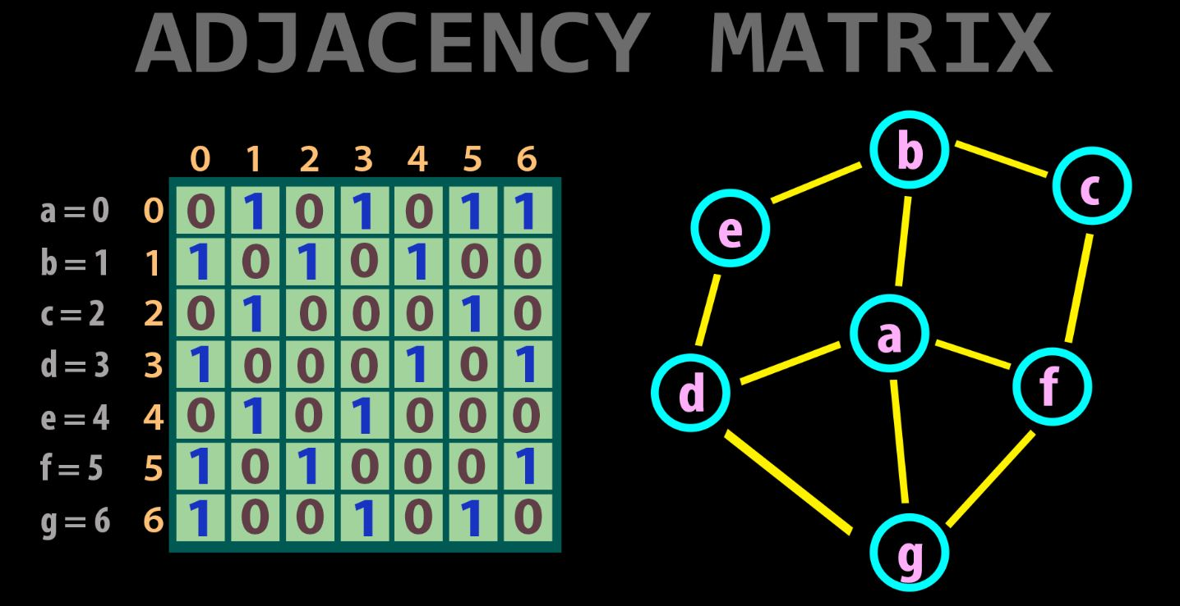
What is the Adjacency matrix?
An adjacency matrix is a way of representing a graph as a matrix of booleans (0's and 1's). A finite graph can be represented in the form of a square matrix on a computer, where the boolean value of the matrix indicates if there is a direct path between two vertices.

Slide 3
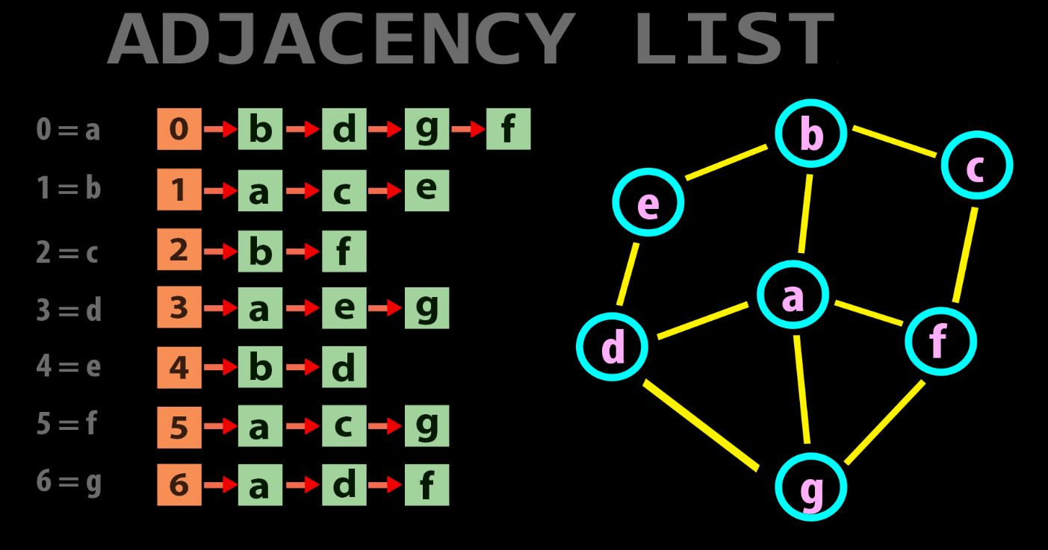
What is the Adjacency list?
An adjacency list represents a graph as an array of linked lists. The index of the array represents a vertex and each element in its linked list represents the other vertices that form an edge with the vertex.

Slide 4
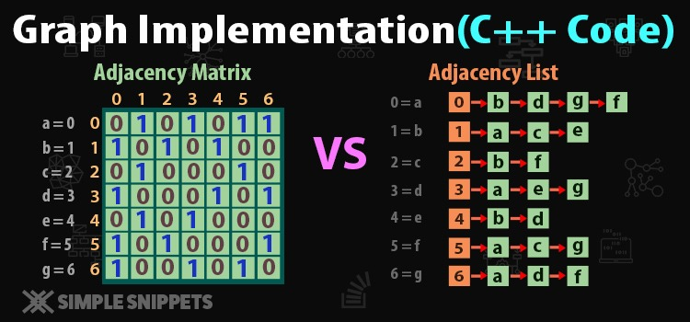

Slide 5
Explanation of the code.
Adjacency Matrix: Adjacency Matrix is a 2D array of size V x V where V is the number of vertices in a graph. Let the 2D array be adj[][], a slot adj[i][j] = 1 indicates that there is an edge from vertex i to vertex j.
Adjacency List: An array of lists is used. The size of the array is equal to the number of vertices. Let the array be array[]. An entry array[i] represents the list of vertices adjacent to the ith vertex.
To convert an adjacency matrix to the adjacency list. Create an array of lists and traverse the adjacency matrix. If for any cell (i, j) in the matrix “mat[i][j] = 1“, it means there is an edge from i to j, so insert j in the list at i-th position in the array of lists.

